Slide 1
ECONOMIC PERFORMANCE
Indicators of Economic Performance

Slide 2
Economic Goals
List what economic goals you think the government has in relation to:
Economic Growth
Unemployment
Inflation

Slide 3
Learning Intentions
To be able to describe and annotate a business cycle graph.
To be able to describe what GDP is as an economic indicator and how it is measured.

Slide 4
Economic Performance
The three main indicators of economic performance are:
Economic growth
Unemployment
Inflation
Australia is a medium-sized, open economy
Economic growth and GDP: the most important indicator of economic performance is Gross Domestic Product (GDP)

Slide 5
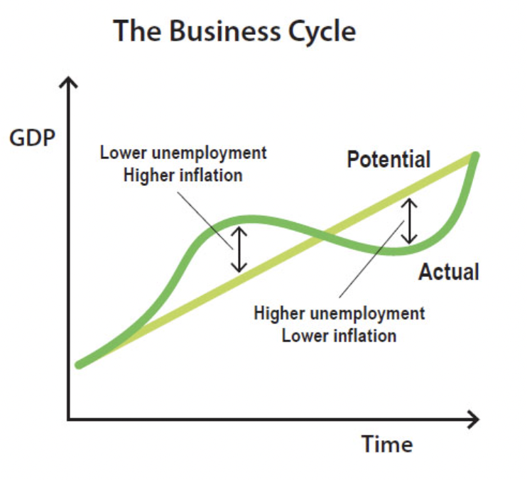
The Business Cycle
The business cycle refers to fluctuations in economic growth relative to growth in potential output. Monetary policy is one tool used to smooth fluctuations in the business cycle.

Slide 6
The Business Cycle
In the upswing stage of the business cycle, there is usually strong growth in GDP and employment. As a result, the unemployment rate declines and inflation starts to increase.
The period of 2005–08 could be characterised as an upswing, as high commodity prices and mining investment contributed to strong economic growth. As the economy began to reach capacity constraints, wages growth and inflation began to increase. Around this time, the Reserve Bank increased the cash rate to put downward pressure on inflation.

Slide 7
The Business Cycle
In 2008, the global financial crisis put downward pressure on economic activity. Economic growth in Australia slowed, and we experienced other characteristics associated with a downturn. Growth in GDP and employment declined, and the unemployment rate increased. During this period, the cash rate was reduced to stimulate demand and support the economy.

Slide 8
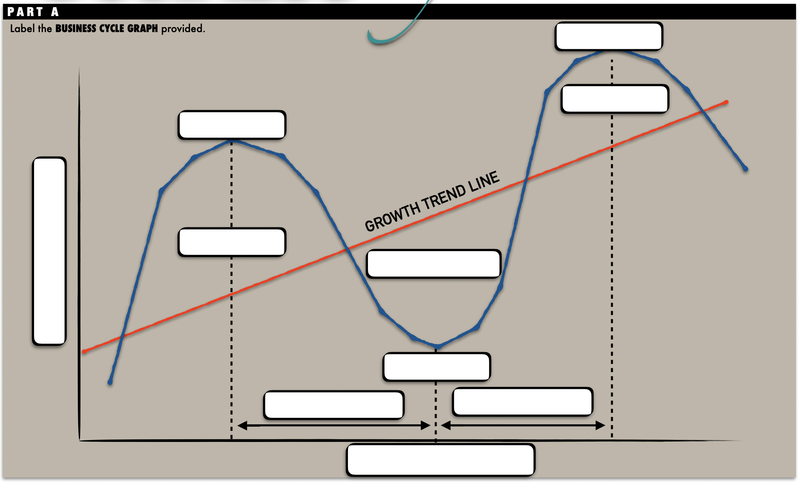

Slide 9

https://www.youtube.com/watch?v=Y5jr_zv2Y9M
Notes:
https://www.youtube.com/watch?v=Y5jr_zv2Y9M

Slide 10
Gross Domestic Product
GDP measures the entire output of an economy in a given year and is a monetary figure representing the value of all goods and services produced
Measuring GDP is important as provides a snapshot of the economy and everything produced in it
GDP per capita: takes a country’s GDP and divides it by the population, to provide more context as to the wellbeing of each person in a country
Limitations of GDP: GDP does not calculate factors which would be considered important to wellbeing such as volunteer work and leisure time

Slide 11
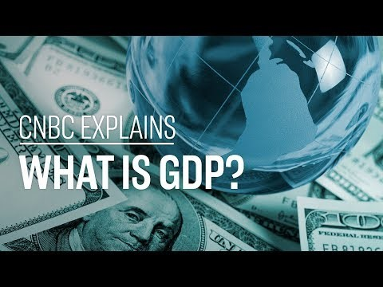
What is GDP? | CNBC Explains - YouTube
Notes:
What is GDP? | CNBC Explains – YouTube

Slide 12
